Slide 1
PART I
Overview of Data Communications and Networking

Slide 2
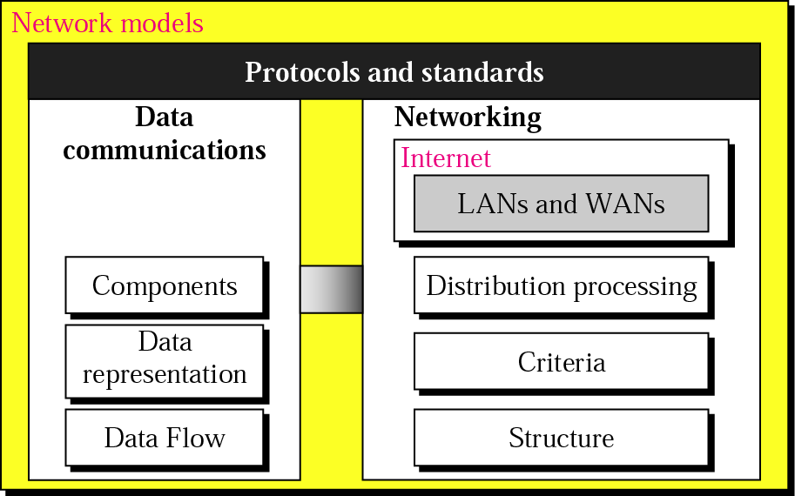
Overview
1.<number>

Slide 3

Chapter 1: Introduction
Chapter 2:Network Models
1.<number>
Copyright © The McGraw-Hill Companies, Inc. Permission required for reproduction or display.
Notes:
1.#

Slide 4
1-1 DATA COMMUNICATIONS
Communication: sharing information. Sharing can be local (face to face) or remote (over distance)
telecommunication (tele: far) means communication at a distance (telephone, television, telegraphy).
data refers to information presented in whatever form is agreed upon by the parties creating and using the data.
Data communications are the exchange of data between two devices via some form of transmission medium such as a wire cable.
Communicating devices : made up of : H.W( physical equipments )and S.W
1.<number>
Notes:
1.#

Slide 5
1-1 DATA COMMUNICATIONS
Topics discussed in this section:
Effectiveness of data communication
Components of a data communications system
Data Representation
Direction of Data Flow
1.<number>
Notes:
1.#

Slide 6
1-1 DATA COMMUNICATIONS
Effectiveness of data communication depends on :
•Delivery :
System must deliver data to correct destination. Data must be received by only intended device or user.
•Accuracy:
The system must deliver data accurately
•Timeliness:
the system must deliver data in a timely manner. Data delivered later are useless.
•Jitter:
Variation in the packet arrival time. It is the uneven delay in the delivery of audio or video packets.
1.<number>
Notes:
1.#

Slide 7

Figure 1.1 Components of a data communication system
Five components of data communication
Protocol: is a set of rules that governs data communications. It represents an agreement between the communicating devices. Without a protocol two devices may be connected but not communicating.
1.<number>
Notes:
1.#

Slide 8
1-1 Data representation
Text, numbers, images, audio, and video
Text:
• ASCII: 7-bit patteren(128 different symbols)
• Extended ASCII: 8-bit pattern (with an extra 0 at left from 00000000 to 0111111
• Unicode: 32 bits pattern (65,536,216) symbols, which is definitely enough to represent any symbol in the world.
Numbers:
represented by bit pattern (binary number)
Images :
represented by matrix of pixels (picture element), small dot. The size of pixel represent the resolution.
Audio:
represent sound by continuous (analog) signal
Video:
can be analog or digital signal
1.<number>
Notes:
1.#

Slide 9

Figure 1.2 Data flow (simplex, half-duplex, and full-duplex)
1.<number>
Notes:
1.#

Slide 10
1-2 NETWORKS
A network is a set of devices (often referred to as nodes) connected by communication links. A node can be a computer, printer, or any other device capable of sending and/or receiving data generated by other nodes on the network. A link can be a cable, air, optical fiber, or any medium which can transport a signal carrying information.
Topics discussed in this section:
Network Criteria
Physical Structures
Categories of Networks
1.<number>
Notes:
1.#

Slide 11
Network Criteria
Performance
  Depends on Network Elements
  Measured in terms of Delay and Throughput
Reliability
  Failure rate of network components
  Measured in terms of availability/robustness
Security
  Data protection against corruption/loss of data due to:
      Errors
      Malicious users (unauthorized access)
1.<number>
Notes:
1.#

Slide 12
_x0010_Physical Structures
Type of Connection
  Point to Point - single transmitter and receiver
  Multipoint - multiple recipients of single transmission
Physical Topology
  Connection of devices
  Type of transmission - unicast, mulitcast, broadcast
1.<number>
Notes:
1.#

Slide 13
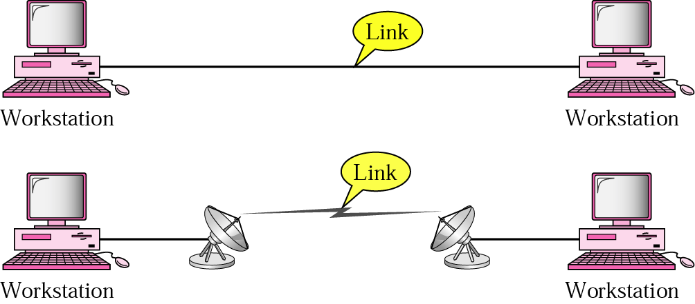
_x0010_Physical Structures (Type of Connection)
  Point to Point - single transmitter and receiver
1.<number>
Notes:
1.#

Slide 14
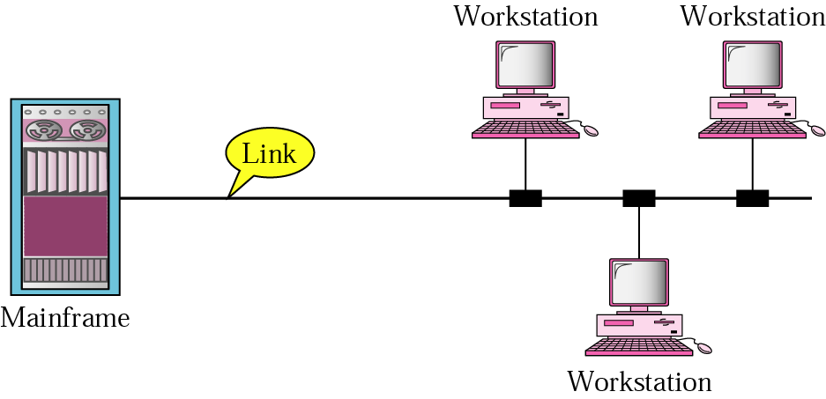
_x0010_Physical Structures (Type of Connection)
  Multipoint (multidrop) connection:
1.<number>
Notes:
1.#

Slide 15

Figure 1.4 Categories of topology
1.<number>
Notes:
1.#

Slide 16

Figure 1.5 A fully connected mesh topology (five devices)
1.<number>
Notes:
1.#

Slide 17

Figure 1.6 A star topology connecting four stations
1.<number>
Notes:
1.#

Slide 18

Figure 1.7 A bus topology connecting three stations
1.<number>
Notes:
1.#

Slide 19

Figure 1.8 A ring topology connecting six stations
1.<number>
Notes:
1.#

Slide 20

Figure 1.9 A hybrid topology: a star backbone with three bus networks
1.<number>
Notes:
1.#

Slide 21
_x0010_Categories of Networks
Local Area Networks (LANs)
  Short distances
  Designed to provide local interconnectivity
Metropolitan Area Networks (MANs)
  Provide connectivity over areas such as a city, a campus
Wide Area Networks (WANs)
  Long distances
  Provide connectivity over large areas
1.<number>
Notes:
1.#

Slide 22
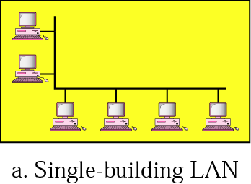
Single building LAN
1.<number>
Notes:
1.#

Slide 23
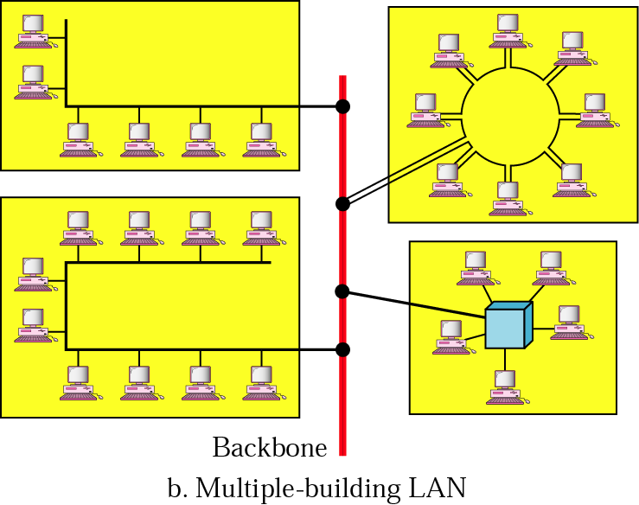
Multiple -building -LAN
1.<number>
Notes:
1.#

Slide 24
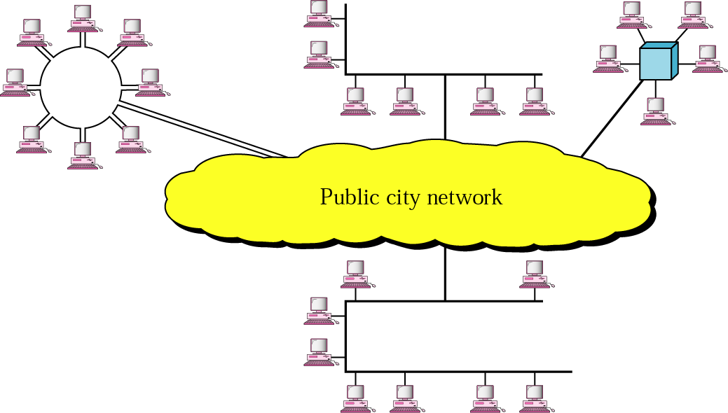
MAN
1.<number>
Notes:
1.#

Slide 25
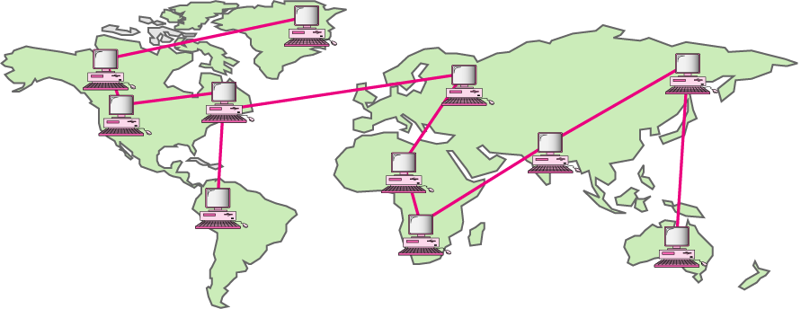
WAN
1.<number>
Notes:
1.#

Slide 26
1-3 THE INTERNET
Interconnections of networks :
internetwork
An internet (small i) is two or more networks that can communicate with each other.
Internet:
Internet is a collaboration of more than 100 of 1000 interconnected network.
1.<number>
Notes:
1.#

Slide 27
1-4 PROTOCOLS
A protocol is consists of a set of rules that govern data communications. It determines what is communicated, how it is communicated and when it is communicated. The key elements of a protocol are syntax, semantics and timing
Topics discussed in this section:
Syntax
Semantics
Timing
1.<number>
Notes:
1.#

Slide 28
_x0010_Elements of a Protocol
Syntax:
Structure or format of the data, meaning the order in which they are presented.
Example: A simple protocol might expect the first byte of data to be the address of the sender, the second byte to be the address of the receiver and the reset of the stream to be the message itself.
Semantics:
Refers to the meaning of each section of bits.
Example: does an address identify the route to be taken or the final destination of the message.
1.<number>
Notes:
1.#

Slide 29
_x0010_Elements of a Protocol
•Timing:
When data to should be sent?
How fast they can be sent?
Example: If a sender produces data at 100Mpbs but the receiver can process data at only 1Mpbs, transmission will overload the receiver and data will be largely lost.
1.<number>
Notes:
1.#

